Slide 1

Introduction
PARADISE
Supervisor: Mr. Cat Nghiem Hieu Tuan
Le Cong Dat – Student1022144
Tran Thi Tuyet Duyen – Student1030933
Tran Tan Duy – Student1053750
22 May 2019

Slide 2

Boring life

Slide 3

Busy life

Slide 4


Slide 5


Slide 6

I want some friends

Slide 7
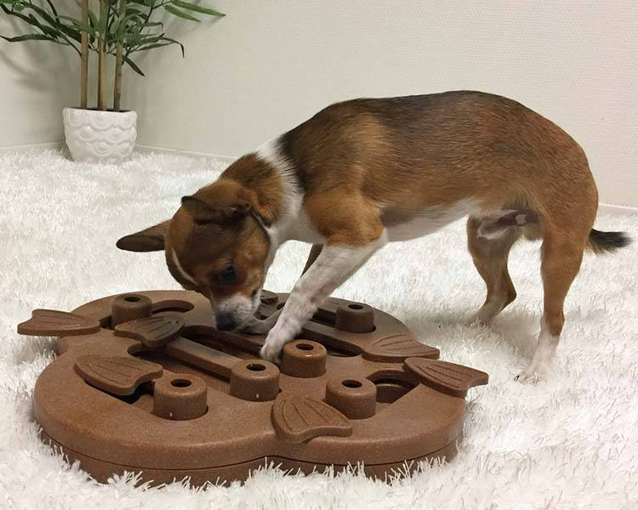
Playing on their own

Slide 8


Thinking???

Slide 9

We are here
Pets
Paradise

Slide 10

happy together

Slide 11

Playing together

Slide 12

Playing together

Slide 13
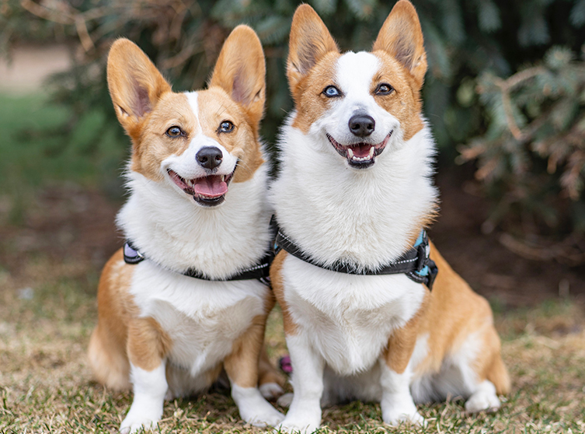
LOVE

Slide 14
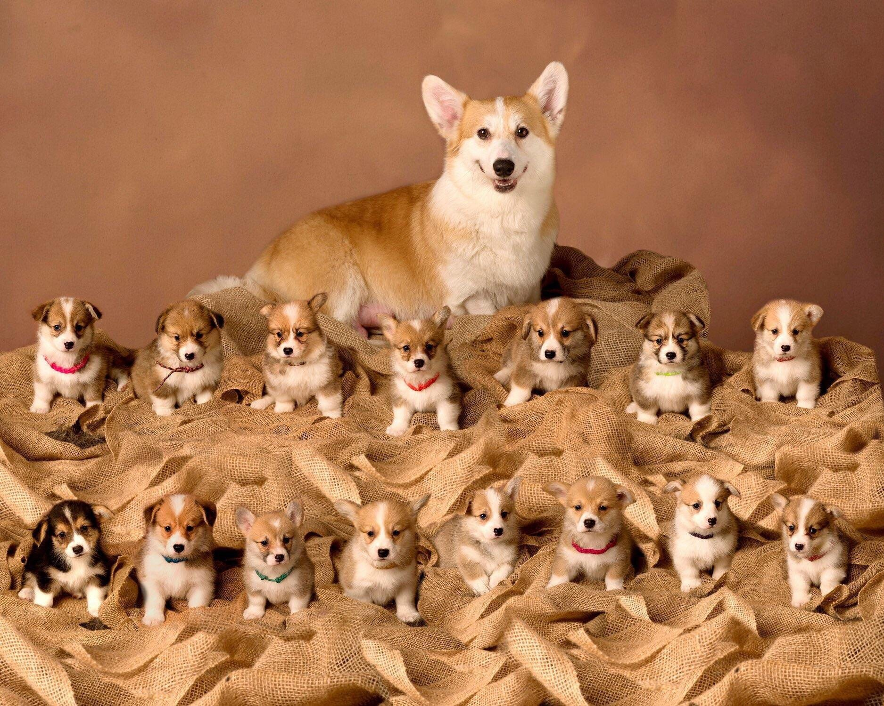

Slide 15

Services

Slide 16

Services

Slide 17

Fastion

Slide 18
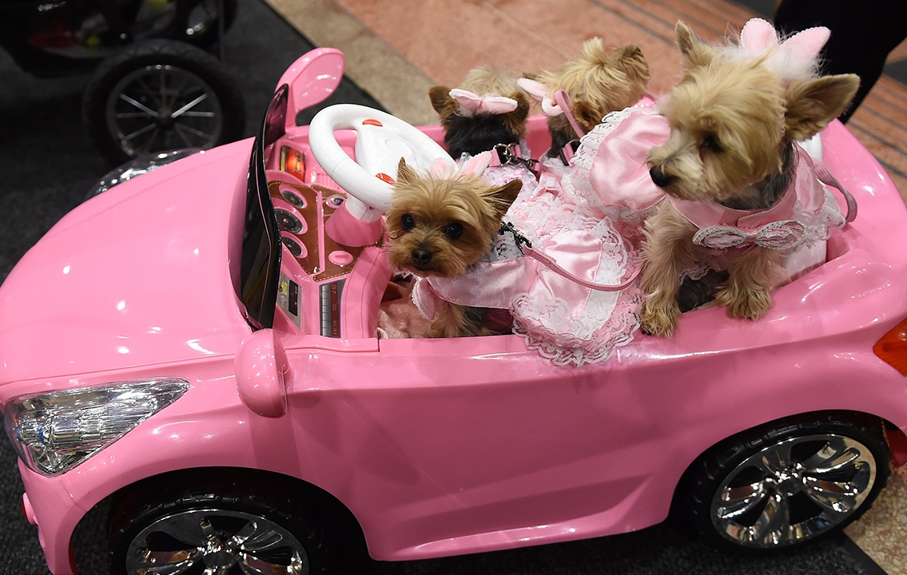
Luxury

Slide 19
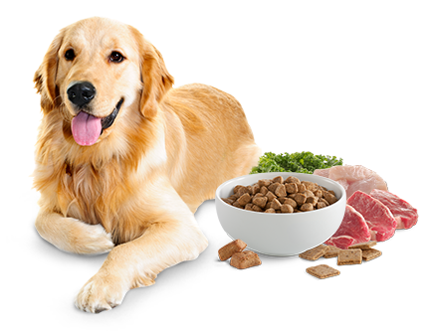
Healthy food

Slide 20
Introduction - Actual requirements
Building a website to enter e-commerce market of Pet
Services
Shop
Pet Dating

Slide 21
Introduction - Requirements of the project
Functional
Admin:
View;
Update (existing product) gallery, services.. ;
Delete Product (supper admin role)
User:
Search for service, product, partner to date with.
Register account
Book service: pet care, pet grooming, pet hotel
Buy products: food, carrier, toy, kennel, collar, treatment products..
Take part in Pet dating club
Notes:
Non-functional (how the system works)
Functional (what the system should do)

Slide 22
Introduction - Requirements of the project
Non-functional
HARDWARE | SERVER
 | Minimum | Recommended
Processor | 800 MHz Intel Pentium III | 2.6 GHz Intel Pentium IV
Memory | 2 GB | 4 GB
Disk space | 8 GB | 16 GB
Monitor | Super-VGA (800x600) or higher resolution monitor
Internet | Internet access is required
 | CLIENT
Processor | 800 MHz Intel Pentium III
Memory | 512 MB
Monitor | Super-VGA (800x600) or higher resolution monitor
Internet | Internet access is required
SOFTWARE | SERVER
Operating System | Windows XP or later
Browser | Google Chrome 65.0
Database | Microsoft SQL Server 2014
Software | Java SDK 1.8
 | GlassFish Server 4.0
 | CLIENT
Operating System | Windows XP or later
Browser | Google Chrome 65.0
Notes:
Non-functional (how the system works)
Functional (what the system should do)

Slide 23
Requirements of the project
Non-functional
DEVELOPMENT SOFTWARE
Microsoft Windows 10
TECHNOLOGY
J2EE
Java SDK 1.8
Netbeans IDE 8.2
Atom 1.36
SQL Server 2016
Google Chrome 74.0
WampServer 3.1.3
Glassfish server 4.1.0
EJB
HTML/CSS
JavaScript
Angular 7
REST API
JWT Token 0.9.1
Node.JS and NPM
Notes:
Non-functional (how the system works)
Functional (what the system should do)

Slide 24
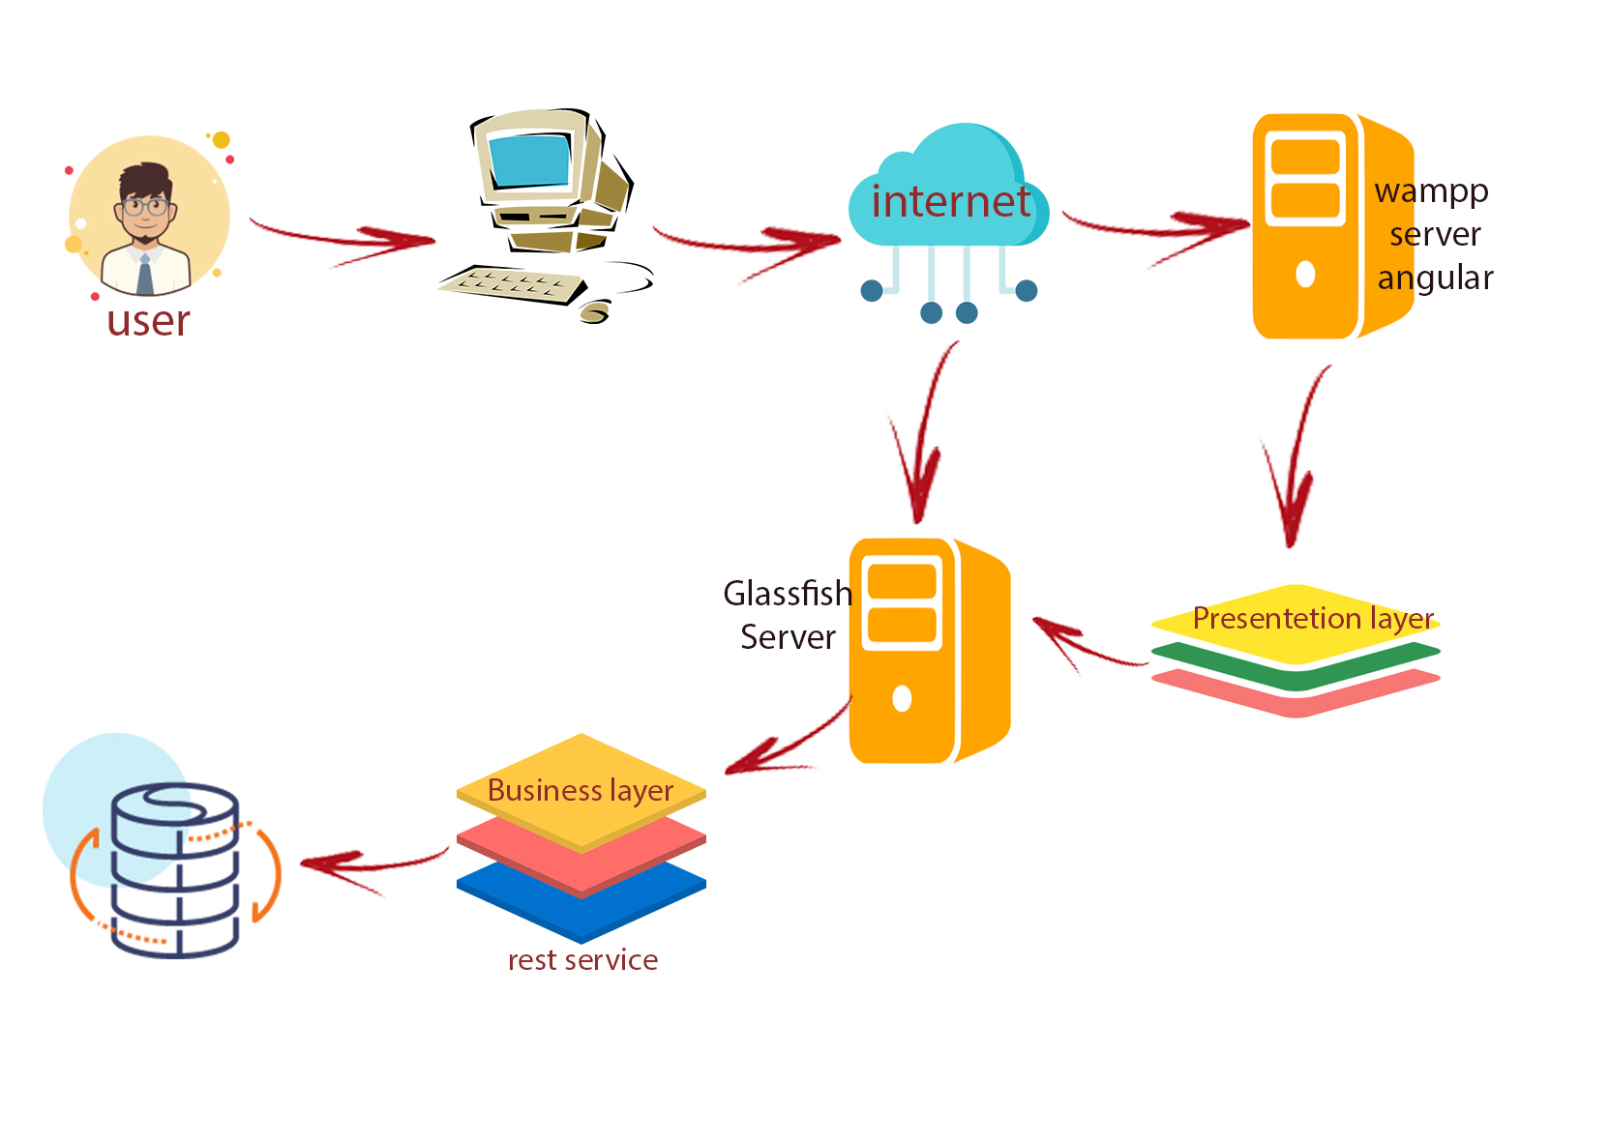
Introduction - Deployment diagram

Slide 25
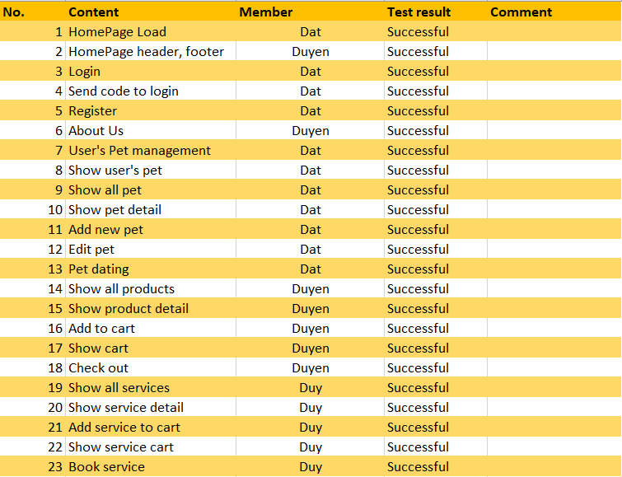
Test Result [1-2]

Slide 26
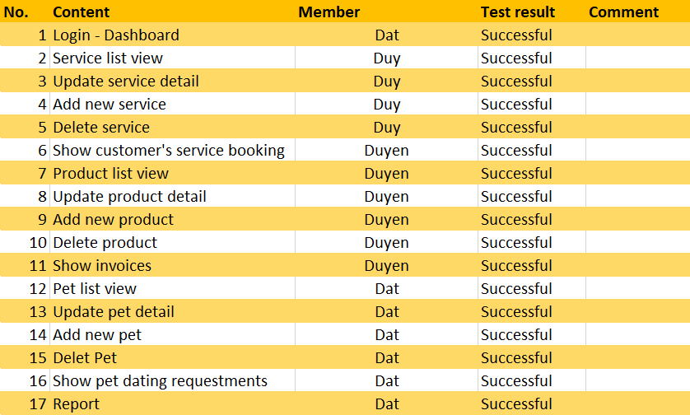
Test Result [2-2]

Slide 27
Task List
Le Cong Dat
Login
Pet Dating
Tran Tuyet Duyen
Category
Shop
Tran Tan Duy
Register
Services

Slide 28

Task List
Advantages
- Using new technology, programming, techniques.
- Website GUI is simple, beautiful and attractive.
- With some features of social network
Disadvantages
- Website has fast response.
- Improve performance website
- Improve UI

Slide 29

Thank You

